Slide 1
Appendix D
The ARM Processor

Slide 2
Appendix Outline
Memory organization
Characteristics of the ARM ISA
Register structure and addressing modes
Instructions and assembly language
Operating modes and exceptions
Input/output

Slide 3
Memory organization
Byte-addressable, 32-bit address space
Little- or big-endian addressable
32-bit word length
Word, half-word, and byte data transfers
to and from processor registers
Word and half-word transfers must be aligned

Slide 4
Instruction set characteristics
RISC-style aspects:
All instructions 32 bits long
Only Load and Store instructions access
memory
Arithmetic and logic instructions operate on
processor register contents

Slide 5
Instruction set characteristics
CISC-style aspects:
Autoincrement, autodecrement, and
PC-relative addressing modes provided
Condition codes used for conditional
execution of instructions
Multiple word Loads and Stores implemented
with single instructions

Slide 6
Unusual aspects of the ISA
Conditional execution of instructions:
All instructions, including branches,
are executed conditionally, based on
a 4-bit condition field value in each
instruction
No explicit shift instructions; but one operand
of an operation can be preshifted
Many multiply instructions, but no divide
instructions

Slide 7
Register structure
Sixteen 32-bit processor registers, labelled
R0 through R15
Register R15 is the program counter (PC)
Registers R13 and R14 have dedicated uses
related to subroutine and processor
stack management
A status register (CPSR) holds the condition
code flags (N, Z, C, V), two interrupt-
disable bits, and five processor mode bits

Slide 8
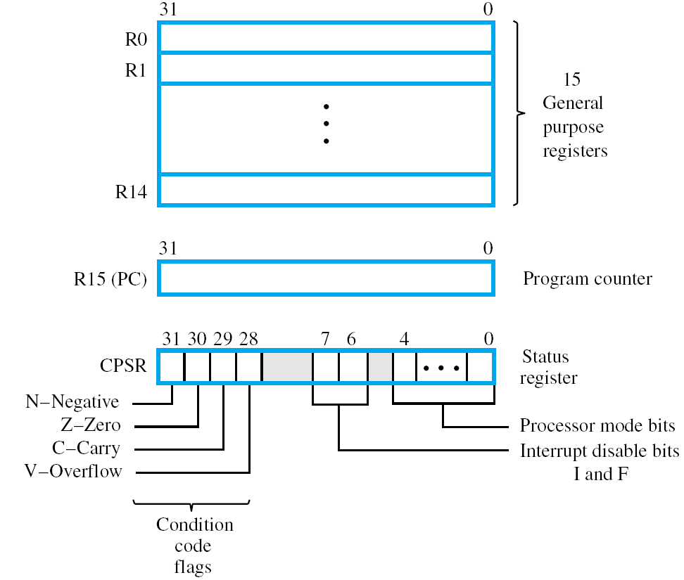

Slide 9
Banked registers
Duplicates of some of the registers in the
range R8 through R14 are provided for
each of the processor modes other than
the User and System modes
Banked registers make context switches
between the modes more efficient
by avoiding register save/restore
operations on such switches

Slide 10
Addressing modes
All modes are derived from a basic form of
indexed addressing
The effective address of a memory operand
is the sum of the contents of a
base register Rn and a signed offset
The offset is either a 12-bit immediate value
in the instruction or the contents of a
second register Rm

Slide 11
Addressing modes
Examples of addressing modes can be shown by using the Load instruction LDR,
whose format is given in following slide
The store instruction STR has same format
Both LDR and STR access a word location

Slide 12
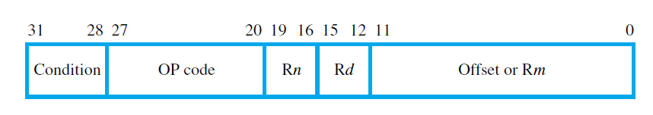

Slide 13
Addressing modes
Pre-indexed mode:
LDR Rd, [Rn, #offset]
performs
Rd ← [[Rn] + offset]
LDR Rd, [Rn, Rm]
performs
Rd ← [[Rn] + [Rm]]

Slide 14
Addressing modes
Relative mode:
LDR Rd, ITEM
performs
Rd ← [[PC] + offset]
where offset is calculated by the assembler

Slide 15
Addressing modes
Pre-indexed with writeback (a generalization
of the autodecrement mode):
LDR Rd, [Rn, #offset]!
performs
Rd ← [[Rn] + offset]
followed by
Rn ← [Rn] + offset
(Rm can be used instead of #offset)

Slide 16
Addressing modes
Post-indexed mode (a generalization of the
autoincrement mode):
LDR Rd, [Rn], #offset
performs
Rd ← [[Rn]]
followed by
Rn ← [Rn] + offset
(Rm can be used instead of #offset)

Slide 17
Addressing modes
If the offset is given as the contents of Rm,
it can be shifted before being used
Example:
LDR R0, [R1, −R2, LSL #4]!
performs
R0 ←[[R1] − 16 × [R2]]
followed by
R1 ← [R1] − 16 × [R2]

Slide 18
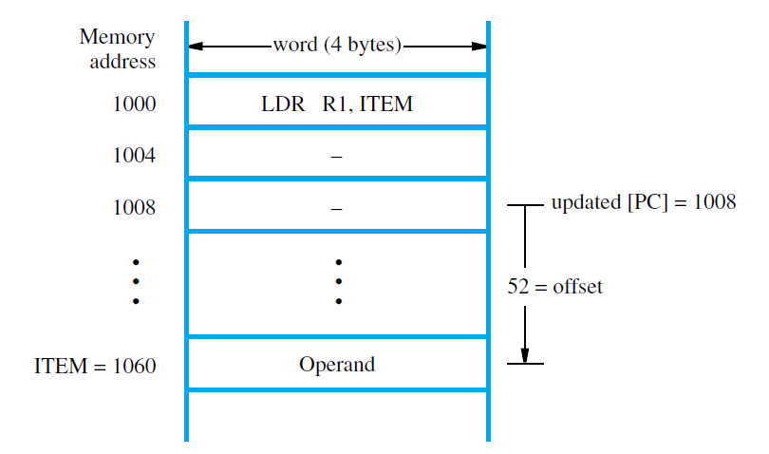

Slide 19
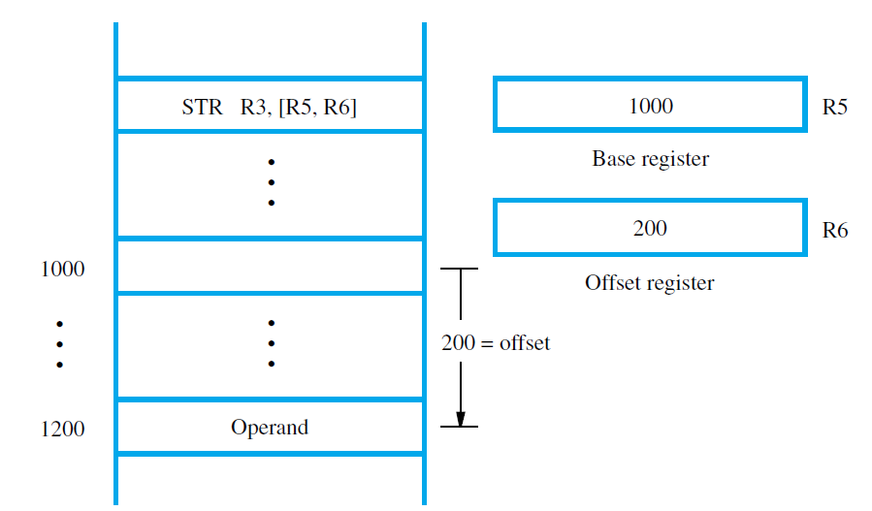

Slide 20
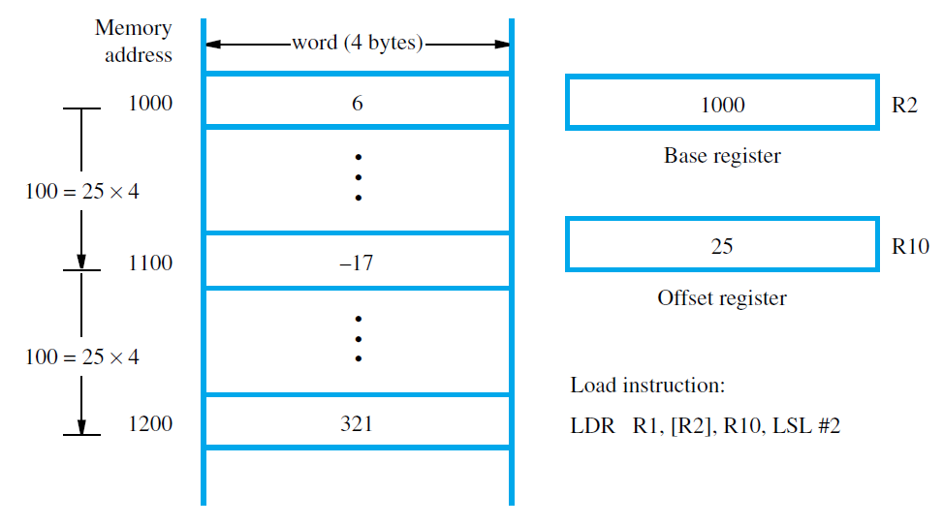

Slide 21
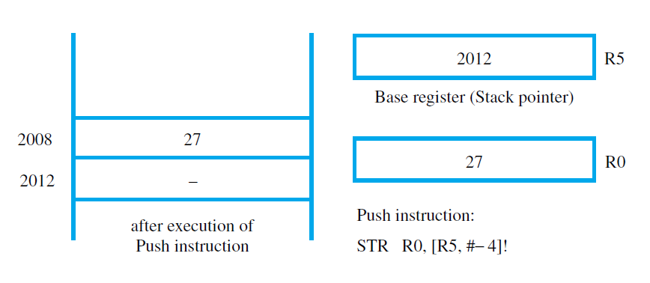

Slide 22
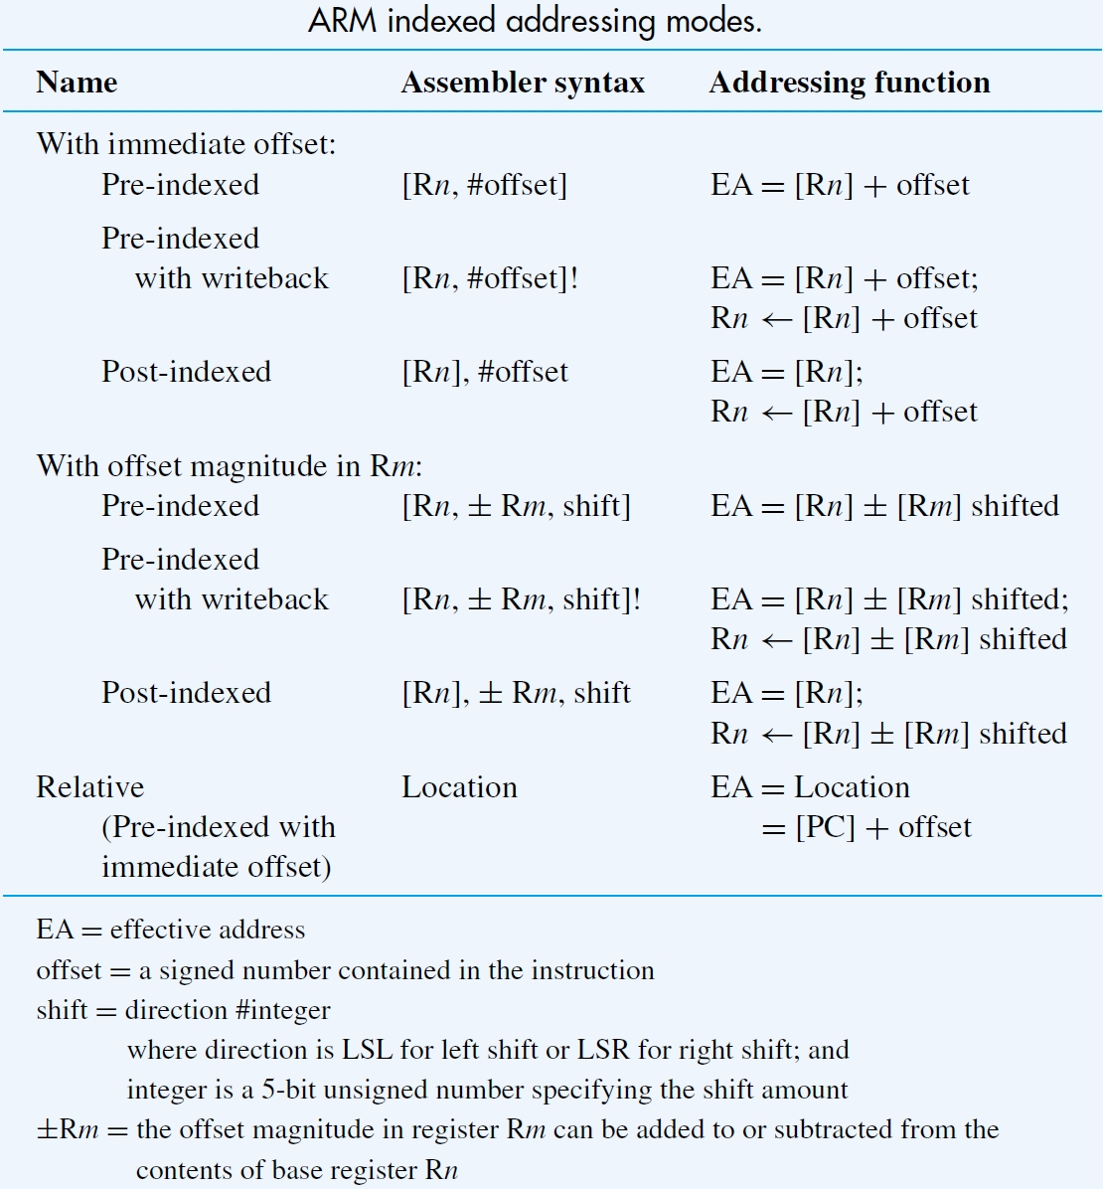

Slide 23
Instructions
Load and Store:
LDR and STR for words
LDRH and STRH for half words
(zero-extended on a Load)
LDRB and STRB for bytes
(zero-extended on a Load)
LDRSH and LDRSB are used for
sign-extended Loads
(Half words and bytes are positioned at the
low-order end of a register)

Slide 24
Instructions
Multiple-word Load and Store:
Any subset of the processor registers can be
loaded or stored with the Block Transfer
instructions LDM and STM
Example: LDMIA R10!, [R0, R1, R6, R7]
If [R10] = 1000, words at 1000, 1004, 1008,
and 1012 are loaded into the registers,
and R10 contains 1016 after all transfers

Slide 25
Instructions
Arithmetic:
Assembly language format is
OP Rd, Rn, Rm or #offset
ADD R0, R2, R4
performs
R0 ← [R2] + [R4]
SUB R0, R3, #17
performs
R0 ← [R3] − 17
(immediates are unsigned values in the range 0 to 255)

Slide 26
Instructions
Arithmetic: The second source operand can be
shifted or rotated before being used
ADD R0, R1, R5, LSL #4
performs
R0 ← [R1] + 16 × [R5]
Shifts and rotations available:
LSL Logical shift left
LSR Logical shift right
ASR Arithmetic shift right
ROR Rotate right

Slide 27
Instructions
Shifting/rotation of the second source operand in arithmetic instructions:
The last bit shifted (or rotated) out is written
into the C flag
A second rotation operation, labelled RRX
(Rotate right extended), includes the C flag
in the bits being rotated; only rotates by 1 bit
(If the second source operand is an immediate
value, a limited form of rotation is provided)

Slide 28
Instructions
Arithmetic:
MUL R0, R1, R2
performs
R0 ← [R1] × [R2]
The low-order 32 bits of the 64-bit product are
written into R0
For 2’s-complement numbers, the value in R0
is correct if the product fits into 32 bits

Slide 29
Instructions
Arithmetic:
MLA R0, R4, R5, R6
performs
R0 ← ([R4] × [R5]) + [R6]
This Multiply-Accumulate instruction is useful
in signal-processing applications
Other versions of MUL and MLA generate
64-bit products

Slide 30
Instructions
Move:
MOV Rd, Rm
performs
Rd ← [Rm]
MOV Rd, #value
performs
Rd ← value
(The second operand can be shifted/rotated)

Slide 31
Instructions
Move:
MVN Rd, Rm or #value
loads the bit-complement of [Rm] or value
into Rd

Slide 32
Instructions
Implementing Shift and Rotate instructions:
MOV Ri, Rj, LSL #4
achieves the same result as the generic
instruction:
LShiftL Ri, Rj, #4

Slide 33
Instructions
Logic:
AND Rd, Rn, Rm
performs the bit-wise logical AND of the
operands in registers Rn and Rm and
writes the result into register Rd
ORR (bit-wise logical OR)
EOR (bit-wise logical XOR)
are also provided

Slide 34
Instructions
Logic:
The Bit Clear instruction, BIC, is closely related
to the AND instruction
The bits of Rm are complemented before they
are ANDed with the bits of Rn
If R0 contains the hexadecimal pattern
02FA62CA, and R1 contains 0000FFFF,
BIC R0, R0, R1
results in 02FA0000 being written into R0

Slide 35
Instructions
Test:
TST Rn, Rm or #value
performs bit-wise logical AND of the two
operands, then sets condition code flags
TST R3, #1
sets Z = 1 if low-order bit of R3 is 0
sets Z = 0 if low-order bit of R3 is 1
(useful for checking status bits in I/O devices)

Slide 36
Instructions
Test:
TEQ Rn, Rm or #value
performs bit-wise logical XOR of the two operands, then sets condition code flags
TEQ R2, #5
sets Z = 1 if R2 contains 5
sets Z = 0 otherwise

Slide 37
Instructions
Compare:
CMP Rn, Rm
performs
[Rn] − [Rm]
and updates condition code flags based on
the result

Slide 38
Instructions
Setting condition code flags
CMP, TST, and TEQ, always update the
condition code flags
Arithmetic, Logic, and Move instructions
do so only if S is appended to the OP code
ADDS updates flags, but ADD does not

Slide 39
Instructions
Adding 64-bit operands
ADC R0, R1, R2 (Add with carry)
performs R0 ← [R1] + [R2] + [C]
If pairs R3,R2 and R5,R4 hold 64-bit operands,
ADDS R6, R2, R4
ADC R7, R3, R5
writes their sum into register pair R7,R6

Slide 40
Instructions
Branch:
B{condition} LOCATION
branches to LOCATION if the settings of the
condition code flags satisfy {condition}
BEQ LOCATION
branches if Z = 1

Slide 41
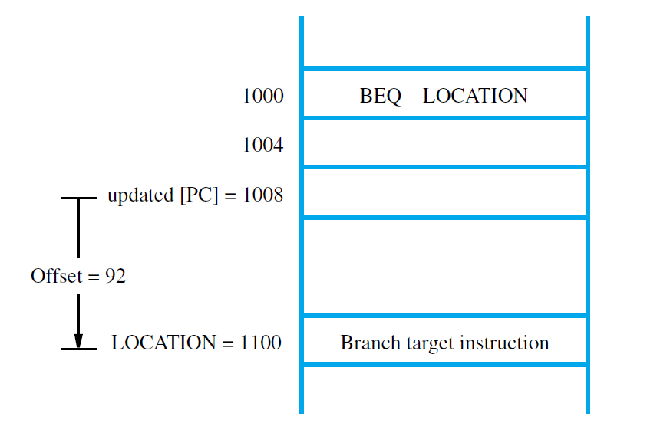

Slide 42
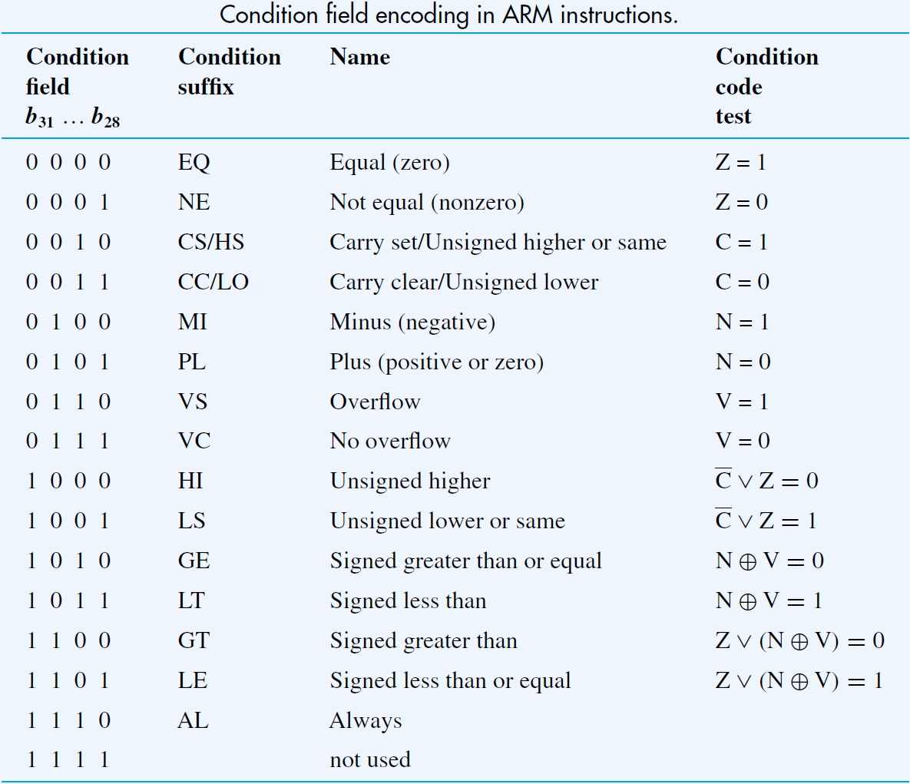

Slide 43
Sample program in the ARM ISA
An assembly-language program for adding numbers stored in the memory is shown
in the next slide
The instruction
LDR R2, =NUM1
is a pseudoinstruction that loads the 32-bit
address value NUM1 into R2
It is implemented using actual instructions

Slide 44
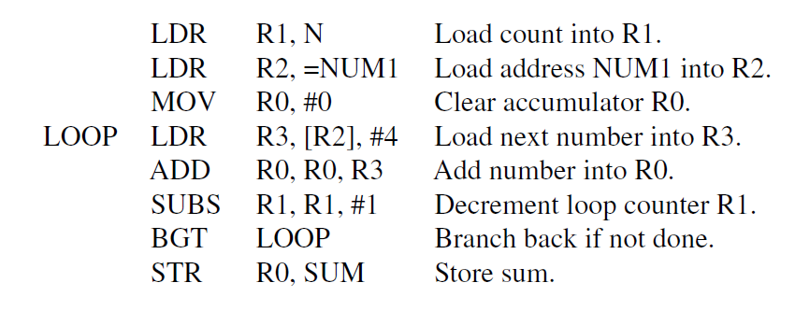

Slide 45
Instructions for subroutines
Subroutine linkage:
BL SUBADDRESS
Actions taken:
1. The value of the updated PC is stored in
R14 (LR), the Link register
2. A branch is taken to SUBADDRESS

Slide 46
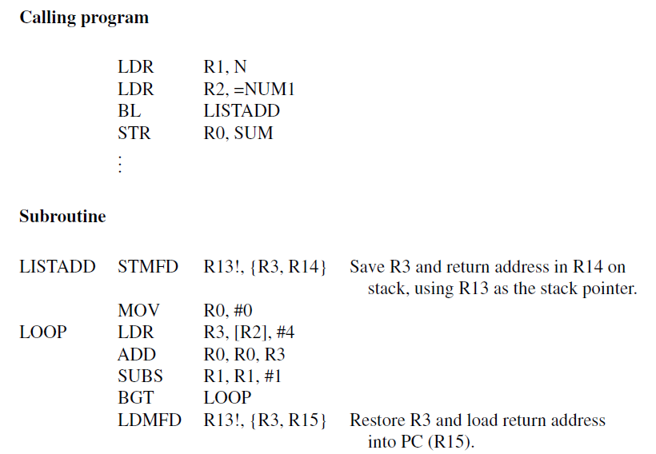

Slide 47
Assembly language
An assembly language program for adding
numbers is given in the next slide
Comments:
1. The AREA directive specifies the start of
instruction (CODE) and data (DATA) areas
2. The ENTRY directive specifies the start
point for program execution

Slide 48
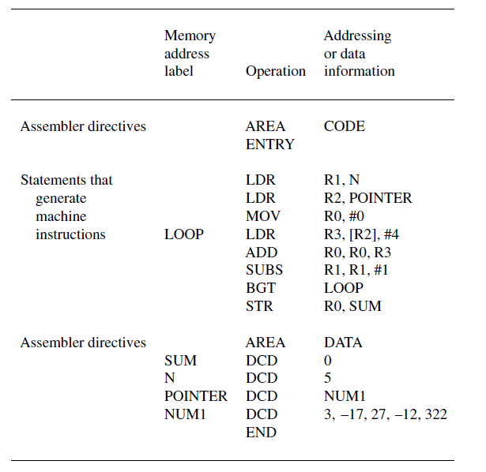

Slide 49
Assembly language
Comments (continued):
3. The combination of the instruction
LDR R2, POINTER
and the data declaration
POINTER DCD NUM1
implements the pseudoinstruction
LDR R2, =NUM1

Slide 50
Pseudoinstructions
Operations specified by pseudoinstructions are
implemented with actual machine instructions
by the assembler
Example: An immediate is an 8-bit unsigned value
The pseudoinstruction
MOV R0, #−5
is implemented with the actual instruction
MVN R0, #4
(the bit-complement of 4 = 00000100
−5 = 11111011)

Slide 51
Pseudoinstructions
Loading 32-bit values:
The pseudoinstruction
LDR Rd, =value
loads a 32-bit value into Rd
LDR R3, =127
is implemented with
MOV R3, #127
(used for “short” values)

Slide 52
Pseudoinstructions
Loading 32-bit values:
LDR R3, =&A123B456
is implemented with
LDR R3, MEMLOC (instruction)
MEMLOC DCD &A123B456 (data)
(used for “long” values, including addresses)

Slide 53
Pseudoinstructions
Loading 32-bit address label values:
If the address is “close” to the current value
of the program counter (R15), the ADR
pseudoinstruction can be used
ADR Rd, LOCATION
is implemented with
ADD Rd, R15, #offset, or
SUB Rd, R15, #offset
(offset is calculated by the assembler)

